Slide 1

Arrays (Part 1)
Prof. Dr. Alp KUT
Asst. Prof. Dr. Derya BİRANT

Slide 2
OUTLINE
What is an Array?
Sample Arrays
Arrays in C#
Examples

Slide 3
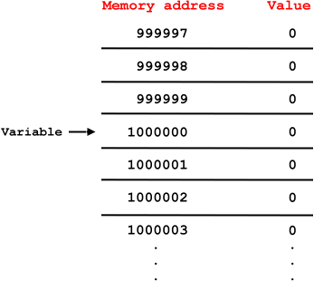
What is an Array?
Arrays allow a group of elements of a specific type to be stored in a contiguous block of memory.
Array is a data structure that contains a number of variables of the same type.
Names
0
Ali Kaya
1
Ahmet Ak
Ayşe Gün
Names[0]
2
Names[1]
3
Sibel Taş
Names[2]
4
Mehmet Kaş
...

Slide 4
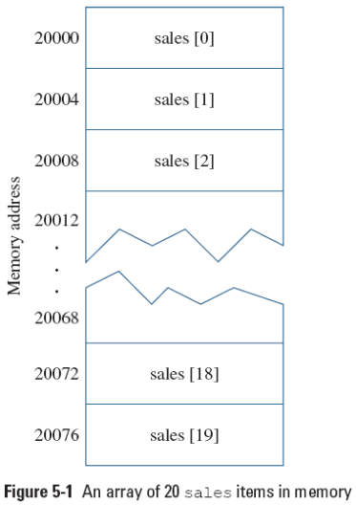
Arrays
Arrays are stored in a contiguous block of memory.
Assigning a value to an array element
sales[0] = 2100.00;
Printing an element value
Console.WriteLine(sales[19]);

Slide 5
Arrays
All values of arrays must be the same type.
Type, dimension and name of array must be determined at definition
Names
0
Ali Kaya
string [ ] Names= new string[3];
Names [0] = “Ali Kaya”;
Names [1] = “Ahmet Ak”;
Names [2] = “Ayşe Gün”;
1
Ahmet Ak
2
Ayşe Gün
Name of array İndex Data

Slide 6
Arrays
Each item is distinguished from the others by an index
  Array’s elements are numbered beginning with 0
Names
0
Ali Kaya
string [ ] Names= new string[3];
Names [0] = “Ali Kaya”;
Names [1] = “Ahmet Ak”;
Names [2] = “Ayşe Gün”;
1
Ahmet Ak
2
Ayşe Gün
Name of array İndex Data

Slide 7
Use of Array
Each element of arrays has one index number
Determining the index of element which you want to reach is necessary
Names
string [ ] Names= new string[5];
Names [1] = “Kerem”;
Names [2] = “Zeynep”;
Console.Write(“Enter name: ”);
Names[3]= Console.ReadLine();
Kerem
Zeynep
Melis

Slide 8
Sample Arrays
grades
int [] grades = new int [6];
  Name of array = “grades”
  Element number of array = 6
  Type of data = Integer
string [] Months = new string[12] ;
  Name of array = “Months”
  Element number of array = 12
  Type of data = String
56
23
81
92
73
34
0
1
2
3
4
5
Months
Jan
Feb
Mar
Apr
May
Jun
Jul
Aug
Sep
Oct
Nov
Dec
0
1
2
3
4
5
6
7
8
9
10
11

Slide 9
Definition of Arrays in C#
Declare
Allocate
Initialize
Access and assign
int[] primes;
int[] primes = new int[9];
int[] primes = new int[9] {2,3,5,7,11,13,17,19,23};
int[] primes = {2,3,5,7,11,13,17,19,23};
primes[0] = 2;

Slide 10
Example 1
int[] numbers = new int[4];
numbers[0] = 3;
numbers[1] = 5;
numbers[2] = numbers[0] + numbers[1];
numbers[3] = numbers[1];
for (int i = 0; i < 4; i++)
Console.WriteLine(numbers[i]);
numbers
numbers
numbers
numbers
numbers
0
0
0
0
3
0
0
0
3
5
0
0
3
5
8
0
3
5
8
5

Slide 11
Example 2
Assign each month to an array
string[] months = new string[12];
months[0] = "Ocak";
months[1] = "Şubat";
months[2] = "Mart";
months[3] = "Nisan";
months[4] = "Mayıs";
months[5] = "Haziran";
months[6] = "Temmuz";
months[7] = "Ağustos";
months[8] = "Eylül";
months[9] = "Ekim";
months[10] = "Kasım";
months[11] = "Aralık";
for (int i = 0; i < 12; i++)
Console.WriteLine(months[i]);

Slide 12
Example 3
Read the name of the months from the user, store them in an array, and then display all months.
string[] months = new string[12];
Console.WriteLine("Please enter month names");
for (int i = 0; i < 12; i++)
months[i] = Console.ReadLine();
for (int i = 0; i < 12; i++)
Console.WriteLine(months[i]);

Slide 13
Example 4
Write program that includes number from 1 to 10
1
2
3
4
5
6
7
8
9
10
int[] numbers = new int[10];
numbers[0] = 1;
numbers[1] = 2;
numbers[2] = 3;
numbers[3] = 4;
numbers[4] = 5;
numbers[5] = 6;
numbers[6] = 7;
numbers[7] = 8;
numbers[8] = 9;
numbers[9] = 10;
for (int i = 0; i < 10; i++)
Console.WriteLine(numbers[i]);
int[] numbers = new int[10];
for (int i = 0; i < 10; i++)
numbers[i] = i + 1;
for (int i = 0; i < 10; i++)
Console.WriteLine(numbers[i]);

Slide 14
Example 5
Write program that puts the even numbers from 2 to 20
2
4
6
8
10
12
14
16
18
20
int[] numbers = new int[10];
for (int i = 0; i < 10; i++)
numbers[i] = (i + 1) * 2;
for (int i = 0; i < 10; i++)
Console.WriteLine(numbers[i]);

Slide 15
Example 6
Write a program that increase all elements in an array by 3
int[] numbers = new int[10] {2, 5, 1, 8, 2, 4, 9, 1, 2, 7};
for (int i = 0; i < 10; i++)
numbers[i] = numbers[i] + 3;
for (int i = 0; i < 10; i++)
Console.WriteLine(numbers[i]);
5
8
4
11
5
7
12
4
6
10

Slide 16
Example 7
Write program that puts the numbers reverse order from 1 to 10
10
9
8
7
6
5
4
3
2
1
int[] numbers = new int[10];
for (int i = 0; i < 10; i++)
numbers[i] = 10 - i;
for (int i = 0; i < 10; i++)
Console.Write(numbers[i]);

Slide 17
Example 8
Read 10 numbers to an array and find each element’s difference between average of elements
double sum=0, average=0;
int[] numbers = new int[10];
for (int i = 0; i < 10; i++)
{
Console.Write("Enter number :");
numbers[i] = Convert.ToInt32(Console.ReadLine());
sum = sum + numbers[i];
}
average = sum / 10;
for (int i = 0; i < 10; i++)
Console.WriteLine(numbers[i] - average);

Slide 18
Example 9
Write program which gets 10 numbers from user and located these numbers to the array and exchange 3. element with 6. element.
Before
4
6
3
0
2
7
4
9
1
10
After
4
6
7
0
2
3
4
9
1
10
int temp;
int[] numbers = new int[10];
for (int i = 0; i < 10; i++)
{
Console.Write("Enter number :");
numbers[i] = Convert.ToInt32(Console.ReadLine());
}
temp = numbers[2];
numbers[2] = numbers[5];
numbers[5] = temp;
Console.WriteLine("Done !");

Slide 19
Example 10
Write the program which adds elements of two arrays to another array and write the elements of result array.
+
=
1
3
6
7
7
2
0
4
8
1
3
3
10
15
8
int [] array1 = new int [5] {1,3,6,7,7};
int [] array2 = new int [5] {2,0,4,8,1};
int [] result = new int [5];
for (int i = 0; i < 5; i++ )
result[i] = array1[i]+array2[i];
for (int i = 0; i < 5; i++)
Console.Write(result[i]);

